Slide 1
Quantifying Interest
Designing neural networks to determine what “catches the eye”?
Nik Bear Brown

Slide 2
Which (if any) do you like?

Slide 3
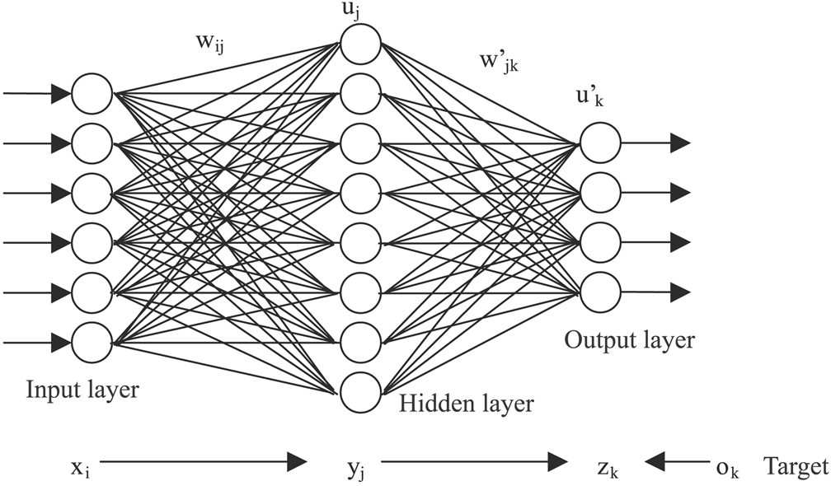
Can we build a model that predicts interest?
Neural networks are models of the brain.

Slide 4
Idea - build a neural model that predicts interest
Extract Features
Data Augmentation
Transfer Learning
Build Predictive Model
Extract Features Predictive Features
Feature Importance
Use Neural Models to Draw Interesting Images
Update Posterior probability for Individuals
Evaluate and Repeat

Slide 5
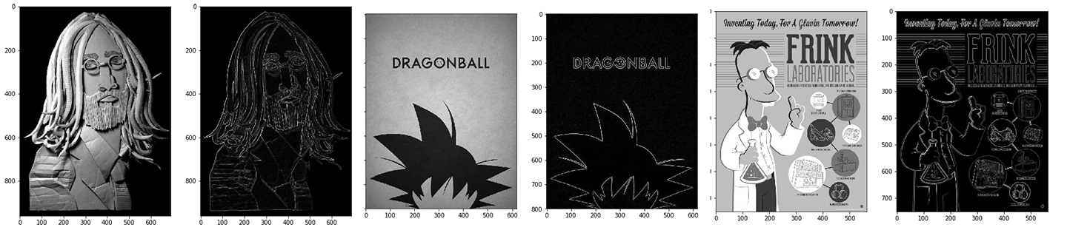
Extract quantitative features
Extract quantitative features from images such and color, edges, brightness, etc.

Slide 6
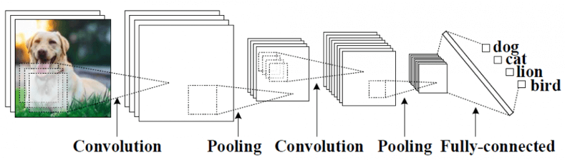
CNN autotaging images
Use a convolutional neural network (CNN) to classify images for semantic content such as person, dog, etc.
Image Credit Using Topological Data Analysis to Understand the Behavior of Convolutional Neural Networks | Ayasdi https://www.ayasdi.com/blog/artificial-intelligence/using-topological-data-analysis-understand-behavior-convolutional-neural-networks/

Slide 7
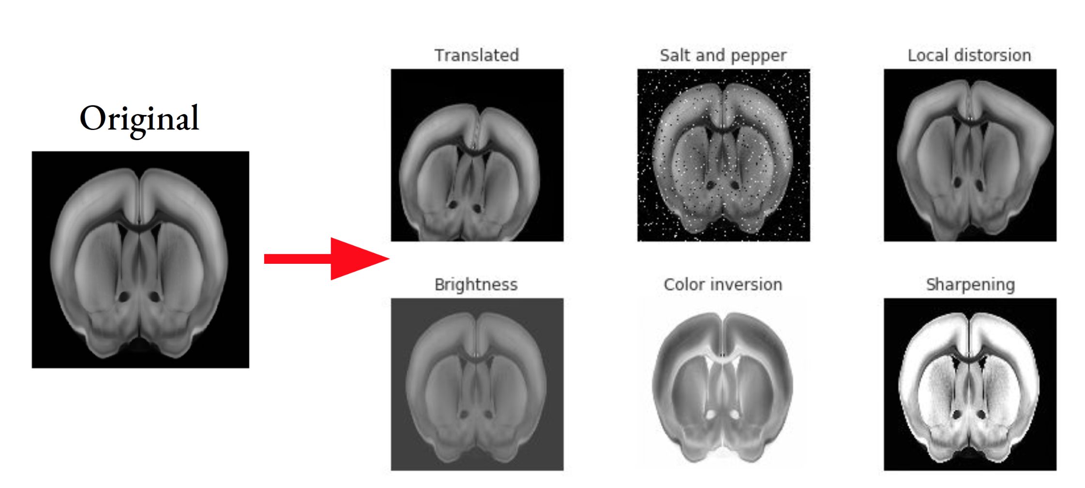
Data Augmentation
Image augmentation
Examples of image augmentation Image credit Tommaso Biancalani of the Broad Institute

Slide 8
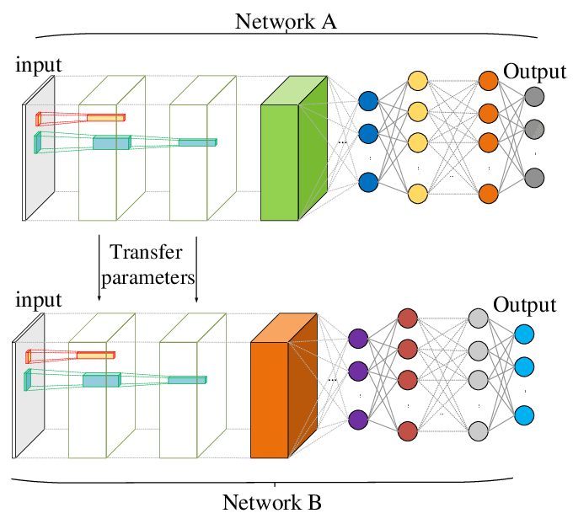
Transfer Learning
Transfer learning is a machine learning method where a model developed for a task is reused as the starting point for a model on a second task.

Slide 9
Transfer Learning
There are many pre-trained models of this type, but the most popular include:
Oxford VGG Model http://www.robots.ox.ac.uk/~vgg/research/very_deep/ Google Inception Model https://github.com/tensorflow/models/tree/master/research/inception Microsoft ResNet Model https://github.com/KaimingHe/deep-residual-networks
Many more models can be found at Model Zoo
https://github.com/BVLC/caffe/wiki/Model-Zoo
.

Slide 10
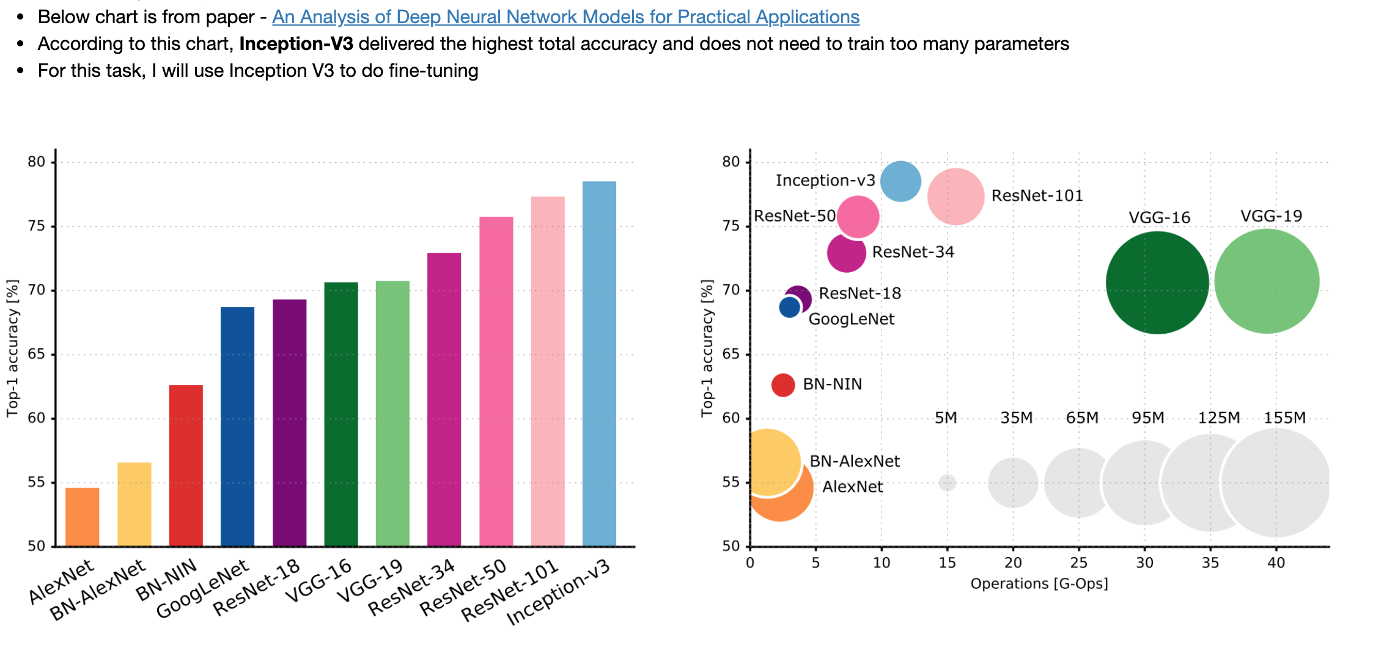
Inception V8
Inception V8 makes sense for this task

Slide 11
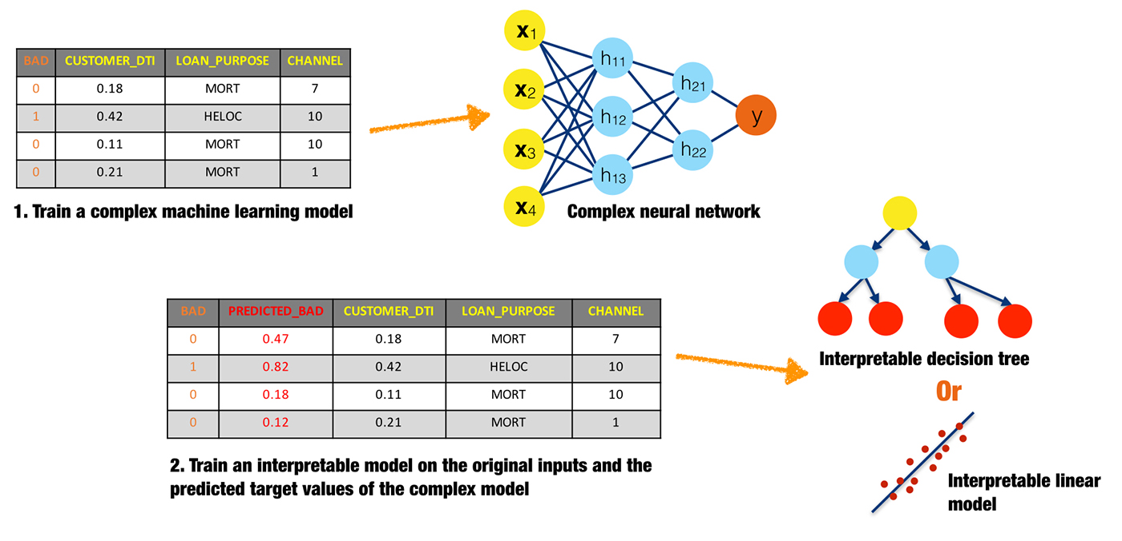
Surrogate Models
Surrogate Models to extract additional features.
Image from Ideas on interpreting machine learning https://www.oreilly.com/radar/ideas-on-interpreting-machine-learning/

Slide 12
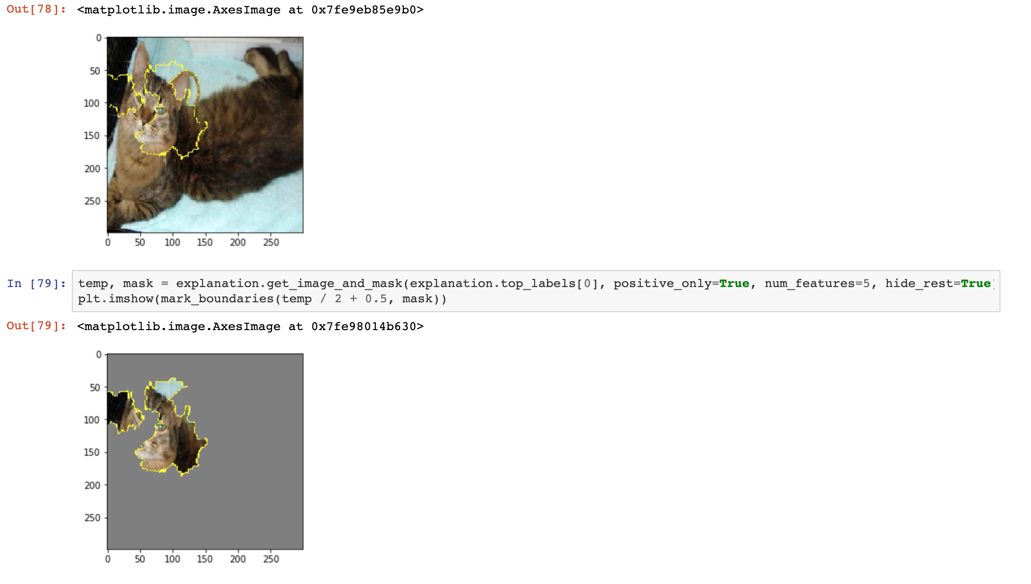
Surrogate Models
Surrogate models can identify image features relevant to predictions
Image credit LIME after CNN classification of images https://nbviewer.jupyter.org/github/mantripragada-manogna/Data-Science-Projects/blob/master/CNN%20Interpretability%20using%20LIME/CNN%20model%20Interpretability%20with%20LIME.ipynb#11.-Citations

Slide 13
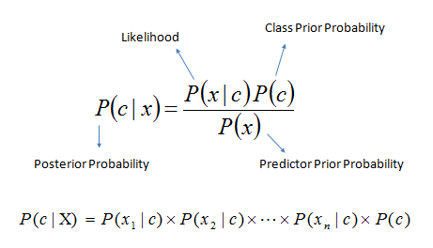
Bayesian Models
Models should generate a probability that can be used a a prior that can incorporate a likelihood for an individual that can be used calculate a posterior probability for an individual.

Slide 14
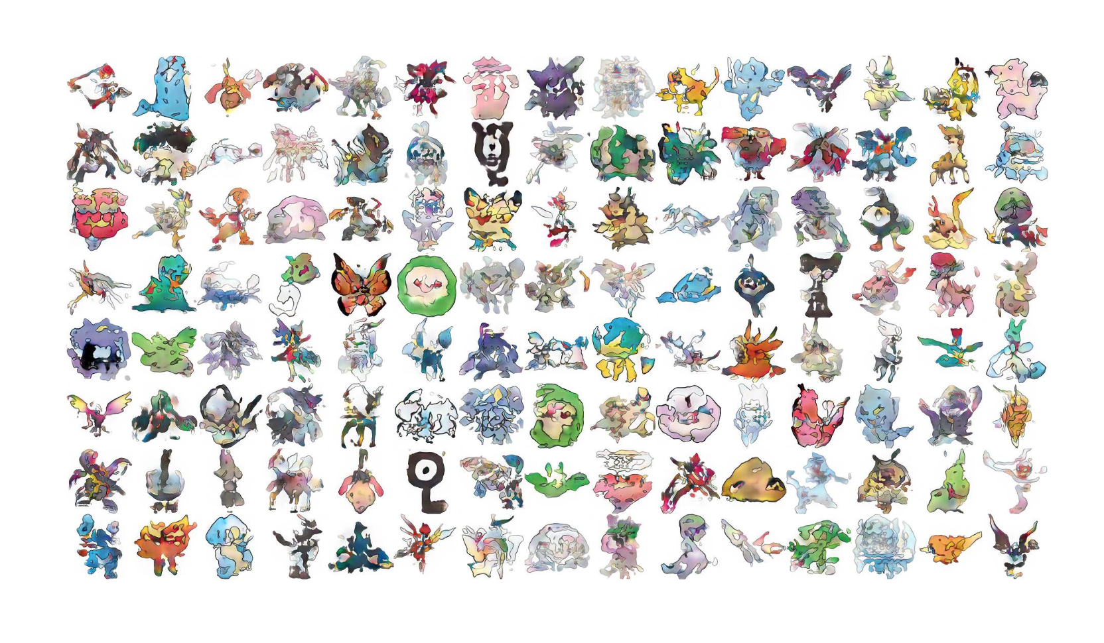
Generative Adversarial Networks (GANs)
Image credit Pokemon Generation using GANs NEU Skunkworks

Slide 15
Generative Adversarial Networks (GANs)
Image credit Progressive Growing of GANs for Improved Quality, Stability, and Variation https://research.nvidia.com/publication/2017-10_Progressive-Growing-of

Slide 16
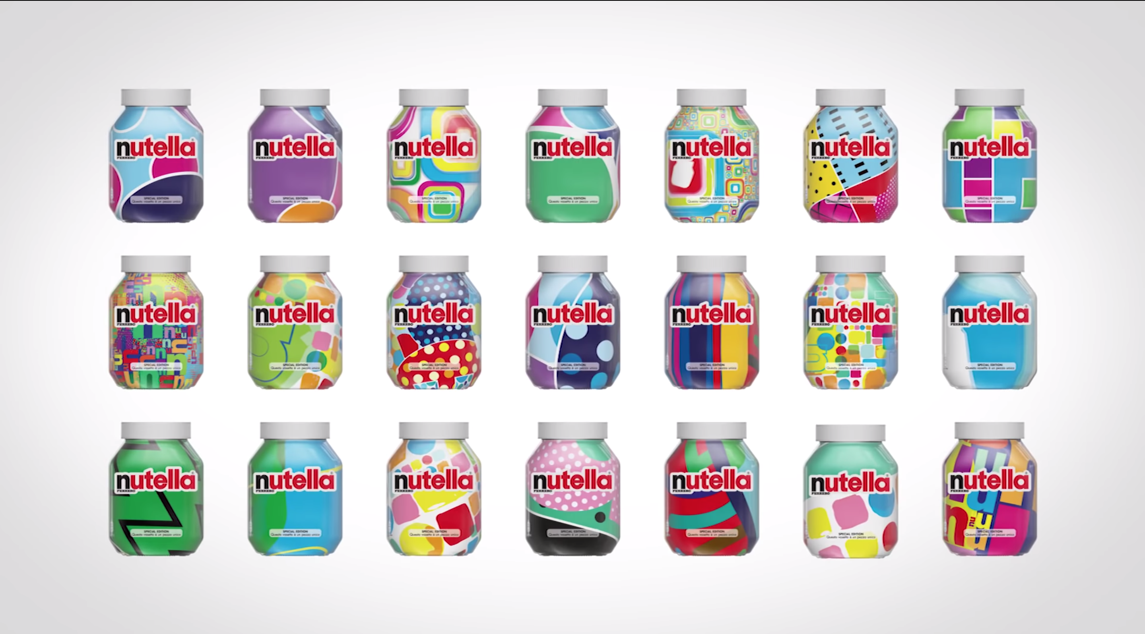
Generative Adversarial Networks (GANs)
Image credit Algorithm designs seven million different jars of Nutella https://youtu.be/sHYakhyvJps

Slide 17

Evaluate
Cross-validate
Live A/B testing

